Slide 1
Movie Industry analysis for Microsoft
To be or not to be
By – Tamjid Ahsan
On – Tue, Mar 23, 2021, 05:00 PM [DST]

Slide 2


Introduction
Industry Overview
One of the thriving industry of modern times
Experiencing a recent boom
Streaming business is lucrative
Seemingly every tech company is in

Slide 3
Business problem
Microsoft wants to get into movie business. They want recommendation.
Movie type that will
- Be profitable
- Increase Microsoft brand recognition

Slide 4
Data processing methodology
Dataset sourced from IMDb and TMDb from 2015 to 2020 detailing
Movie financial data
Movie rating data
Movie production company
Movie genre information
Focused analysis only on English language movie
Dataset size after cleaning and processing: 1113

Slide 5
Recommendation
On seasonality of releases
On movie genres
On profitability of movie franchise

Slide 6
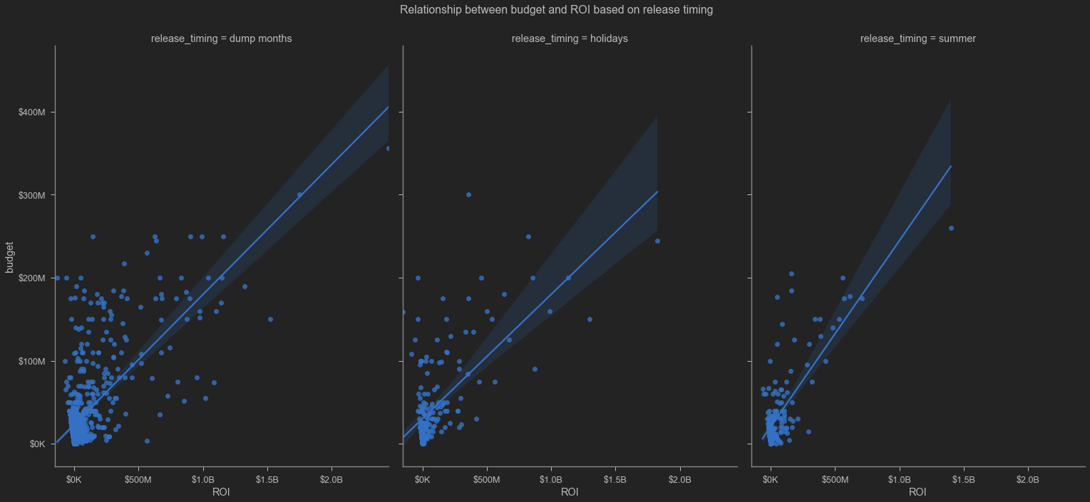
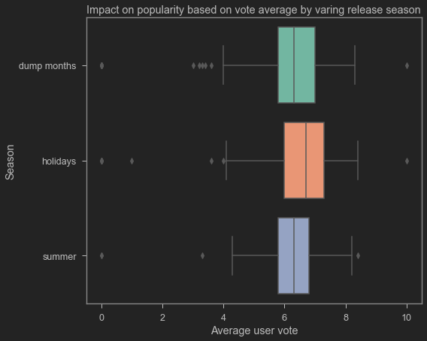
When to release
Focus for release schedule in the holidays season.
Holiday movies are more popular
Good for entering the market with a more favorable impression on people.
Summer releases are more costly,
But summer return is steeper.
Number of movies beyond 500 million is less frequent

Slide 7
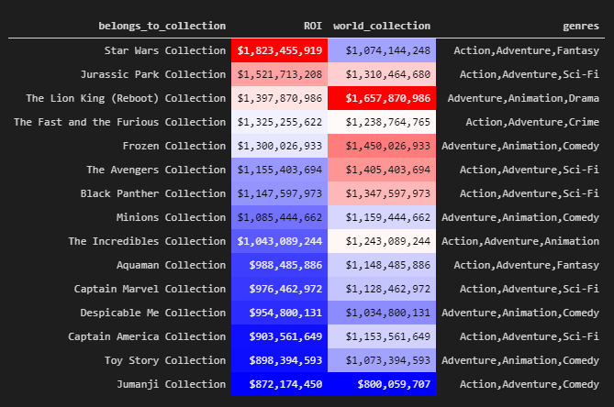
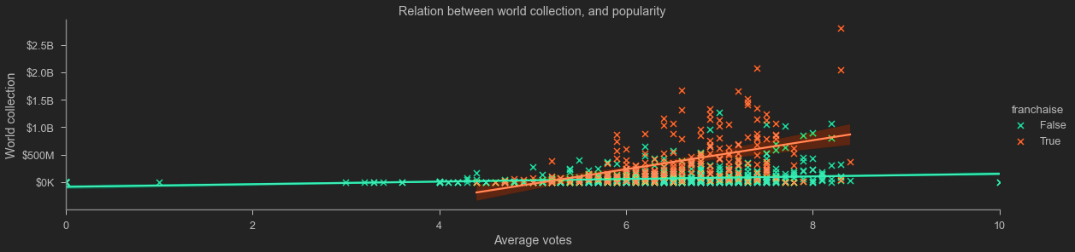
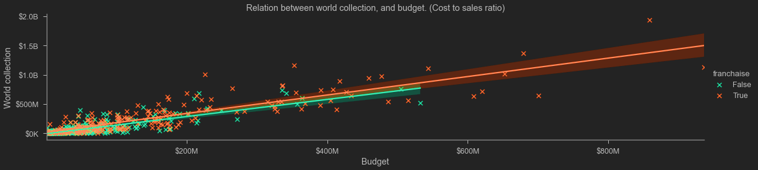
Most successful ones
None of them fall into a single genre
Franchised movies are often more popular
Greater success in international market.

Slide 8
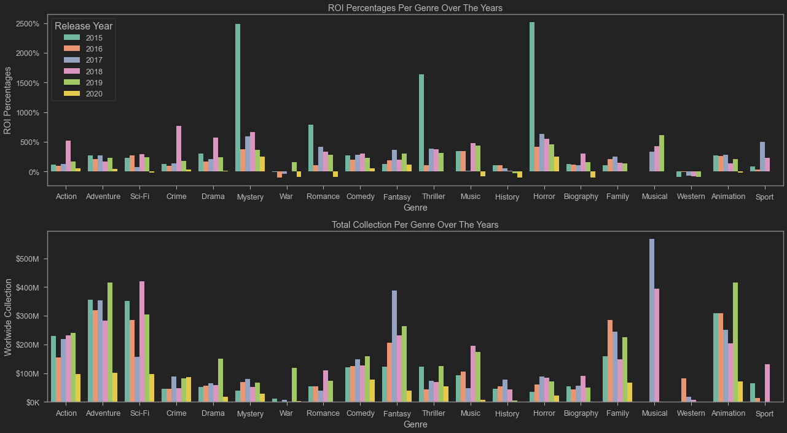
Movie Genre Selection
Any one, or combination of
Action
Adventure
Animation
Avoid
Western
War
History
The most successful movies doesn’t belong to a single genre.

Slide 9
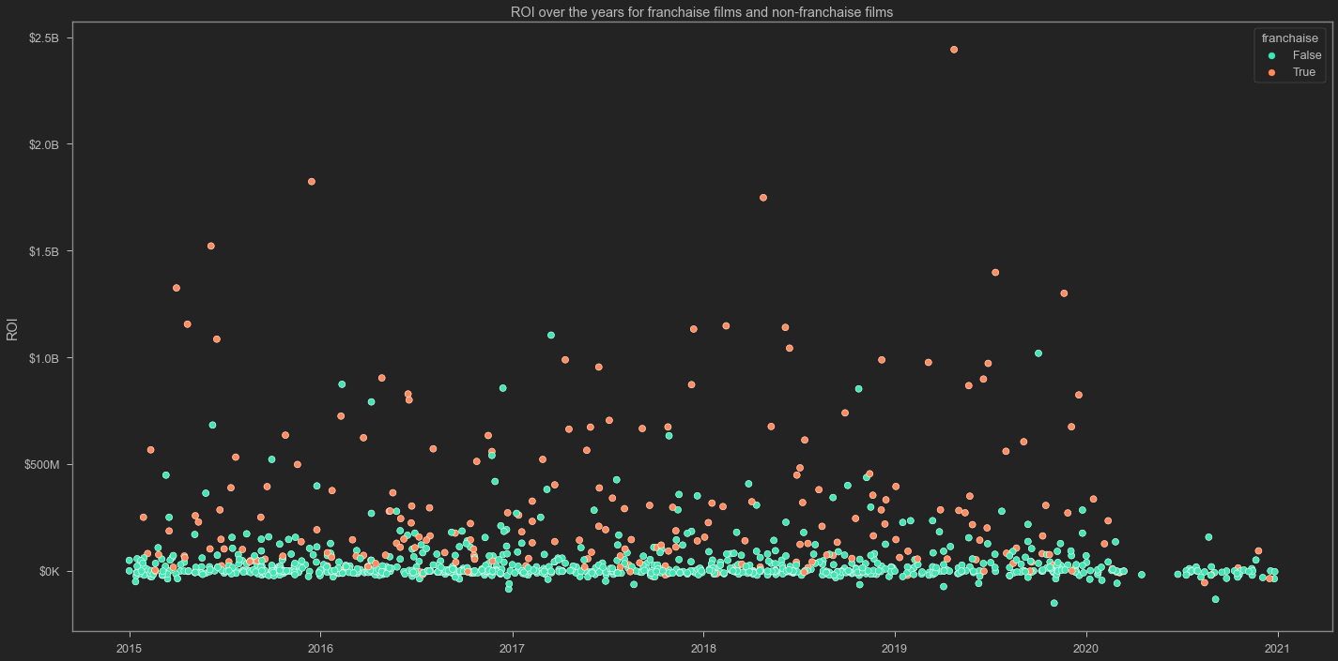
Should we focus on serialization
Short answer:
Definitely
Franchised movies are consistently outperforming
Franchised movies rarely flop

Slide 10
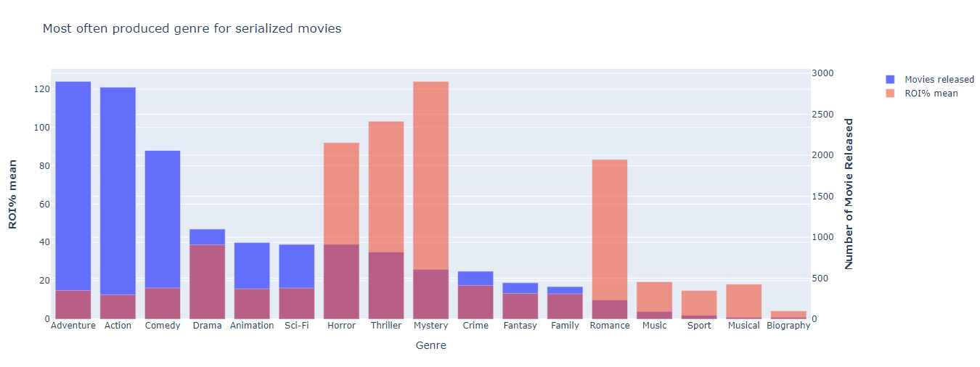
Should we focus on serialization
Then Which genre
Adventure, Action, Comedy market is relatively less saturated with high return percentage.
Drama is highly saturated genre.
Horror, Thriller, Mystery release count is higher with higher mean return percentage.

Slide 11
Conclusion
Release movie in the holidays season
Make a movie in Action-Adventure-Animation genre
Aim to establish a cinematic universe where serialized movies can be produced.

Slide 12
Next steps
Performance of other language movies and markets.
Movie's performance in home and international market.
Recommending lead director.
Recommending movie cast by on genre.

Slide 13

Thank you !!!
GitHub: @tamjid-ahsan
LinkedIn: linkedin.com/in/tamjidahsan/
Project repo: https://github.com/tamjid-ahsan/dsc-phase-1-project

Slide 14
Appendix

Slide 15
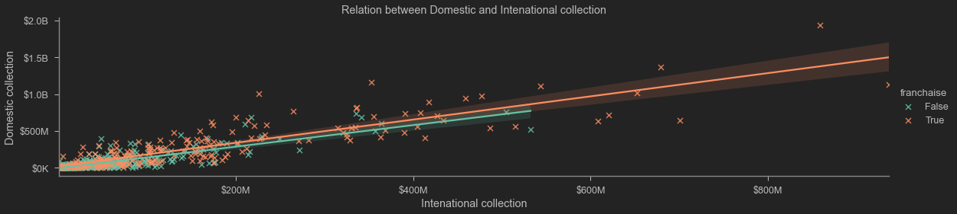
Domestic V International

